Slide 1
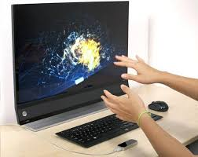
LEAP MOTION
GESTURE CONTROL BY COMBINING THE POWER OF ARDUINO AND PYTHON
Project By:
Mrinal Sen
Pranjalesh Ghansiyal
Samyak Jain
Bunty Agarwal

Slide 2

OBJECTIVE
Main aim is to provide gesture based control.
Ease of use.
Using Arduino and a couple of Ultrasonic sensors to control applications by movement of our hands.
Mapping of gestures to specific actions by the help of Python Programming language.

Slide 3


Concept Behind The Project
The ultrasonic sensors measure the distance between the hands and the sensors.
This information is used to perform selective actions based on the input received .
The sensors are placed on top of the screen on either side .
The distance is read by Arduino and Python collects this information which is converted into key action using PyAutoGUI library.

Slide 4
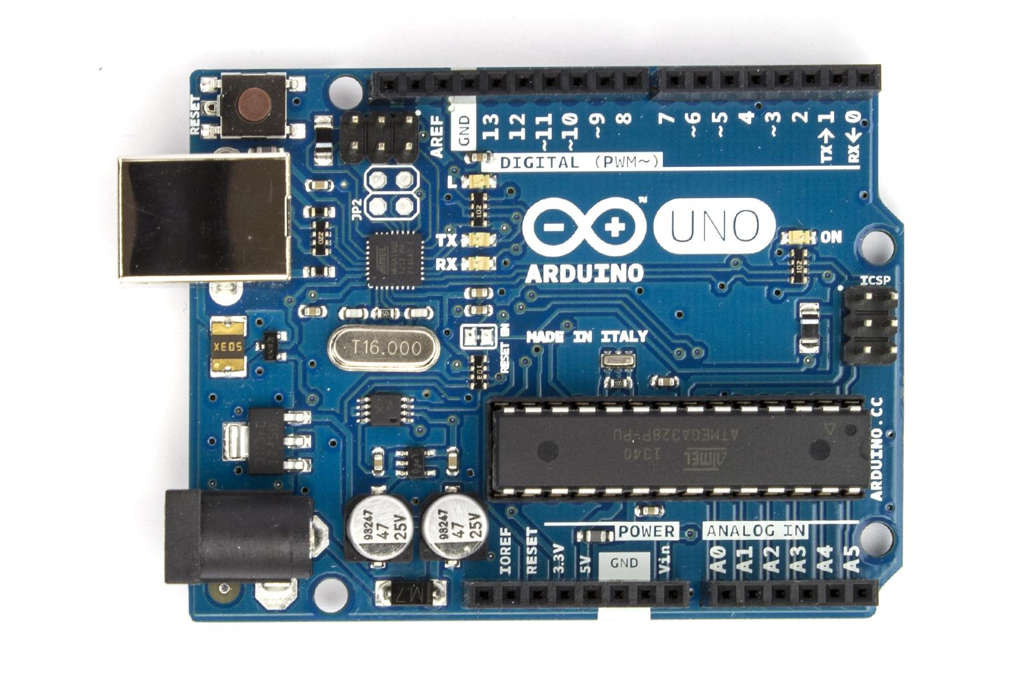
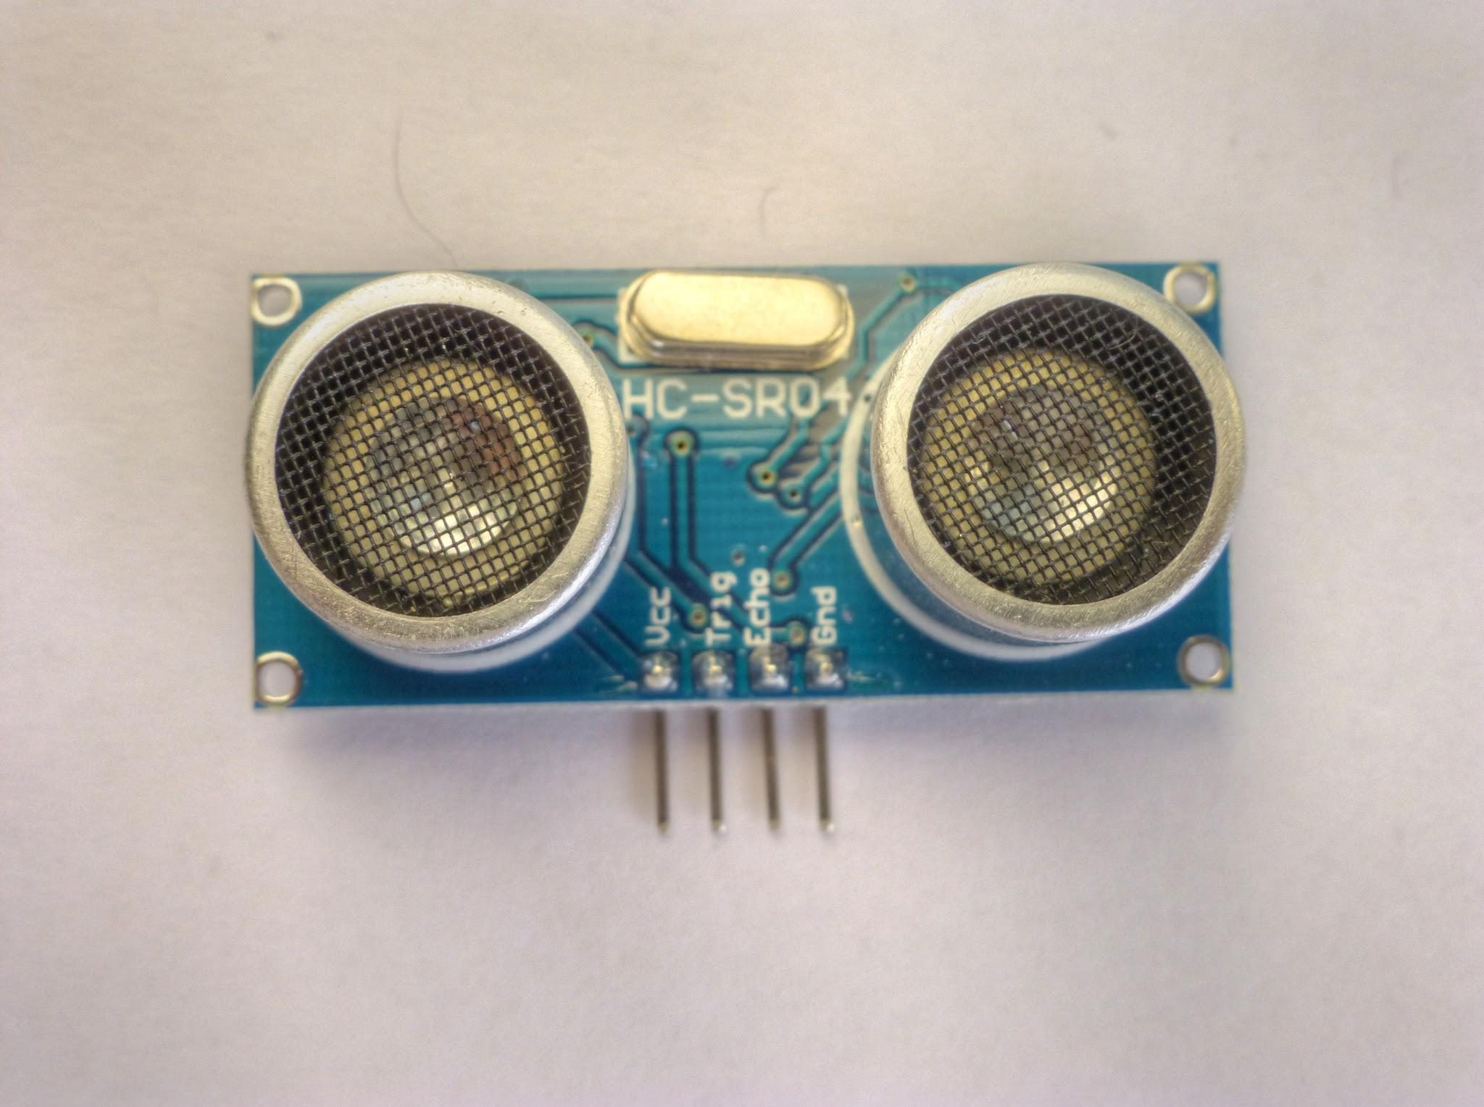

HARDWARE/SOFTWARE REQUIREMENTS
Windows 7 or above
Arduino UNO toolkit
Two ultrasonic sensors
Arduino IDE and Python (pyautogui library)
Core 2 duo processor
2 GB Ram
Male to Female Jumper Cable

Slide 5
DESIGN OF THE PROJECT
The Trigger and Echo Pins of the first Ultrasonic Sensor (that is placed on the left of the screen) are connected to Pins 11 and 10 of the Arduino.
For the second Ultrasonic Sensor, the Trigger and Echo Pins are connected to Pins 6 and 5 of the Arduino.
Both the ultrasonic sensors are placed on top of the laptop screen, one on the left side and other on the right .
The Arduino is placed to the back of the screen and the wires from Arduino are connected to the Trigger and Echo pins of the individual sensors.

Slide 6
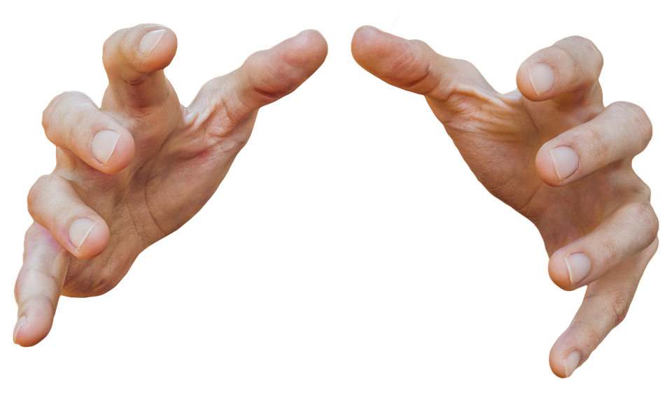
FEATURES
The main features of this project are as follows:-
Quick Switch between two tasks
Scroll Down & Scroll Up in a web page
Switch to next tab in web browser
Fast Forward/Rewind a video in VLC media player
Play/Pause a video in VLC media player
Increase & Decrease the volume

Slide 7

LIMITATIONS
The Ultrasonic Sensors do not guarantee 100% accuracy , special care has to be taken regarding the distance from the sensors at which the gestures can be read properly.
Correct placement and movement of the hands can help in achieving greater accuracy in the output.

Slide 8

Contributions Of This Project
Few hand gestures will perform certain tasks in the computer without using mouse or keyboard.
Minimum efforts to accomplish certain tasks.
Cost of the hardware is negligible as compared to other high end desktop.

Slide 9

CONCLUSION
Implementation of Arduino based Hand Gesture Control of a Computer, where few hand gestures made in front of the computer will perform certain tasks without using mouse or keyboard thereby simplifying gesture based controls.
This type of hand gesture control of computers can be used for VR (Virtual Reality), AR (Augmented Reality), 3D Design, Reading Sign Language, etc.

